Slide 1

Stress Management

Slide 2
What is Stress?
Stress is a physical and psychological response to outside stimuli
Stress can be good or bad
What is your stress level now?
Handout:
Take the Stress Quiz and score the results. What is your current stress level?

Slide 3
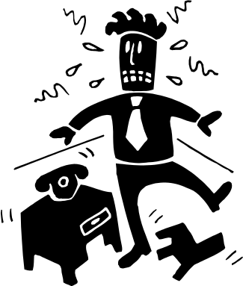
What are your stress triggers?
Stress Pattern Worksheet: Question 1 and 2
List your stress triggers. What causes you stress?
What are recurring stressful events for you?

Slide 4

What do College Students Stress Over?
Taking too many units
Papers and exams
Studying and homework
Work responsibilities
Finances
Personal relationships
Parental conflicts
Too many demands
Career and future success

Slide 5
Experiencing Stress
Stress Pattern Worksheet: Question 3 and 4
What are some physical symptoms or changes that occur when you are stressed?
What are some psychological symptoms or changes that happen during stressful events?

Slide 6

Physical Changes
Heart rate increases
Headaches and migraines
Frequent colds, sinus infections, flu symptoms
Constant feeling of tiredness
Allergy or asthma attack
Upset stomach, indigestion, heartburn, ulcers

Slide 7
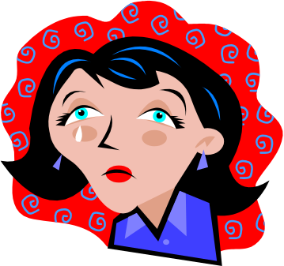
Psychological Changes
May experience difficulty in your ability to think clearly (confusion, trouble concentrating, inability to remember things, poor problem solving)
May experience emotions such as fear, anxiety, depression, irritability, anger or frustration
May experience insomnia or difficulty with sleeping

Slide 8
How do you respond to stress?
Stress Pattern Worksheet – Question 5
How do you react or respond to stress on these levels?
Emotional
Behavioral
Physical

Slide 9
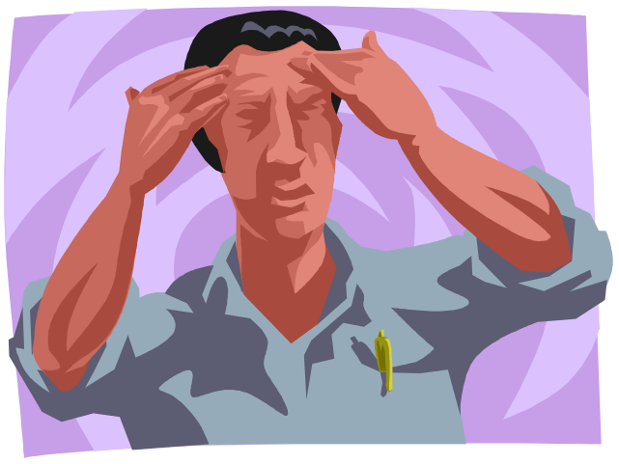
Emotional Reactions
Depression
Anxiety
Taking your stress out on others
(lashing out, angry outbursts)

Slide 10



Behavioral Response
Eating, drinking or sleeping too much
Zoning out in front of the TV or computer
Allowing negative thinking to take over
Starting bad habits such as smoking/drinking
Spending too much money

Slide 11

Physical Response
Blood pressure goes up
Skin problems
Back pain
Muscles tighten up and joint pain
Lowered immune system

Slide 12
How do you manage stress?
Stress Pattern Worksheet: Question 6
How do you manage or reduce stress in your life?

Slide 13


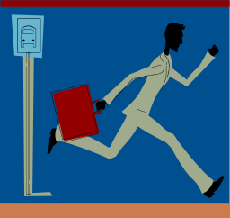
Manage Time to Reduce Stress
Determine your peak energy levels of the day - schedule classes when you’re most alert
Balance time and energy on things that matter
Follow a regular schedule - include study time, work, sleep and relaxation
Minimize stress by planning in advance
Avoid sleep deprivation - can lead to accidents, increased mistakes, anxiety, depression

Slide 14
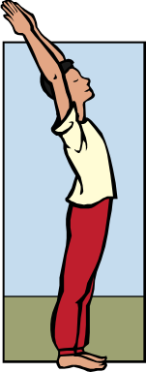

Adjust your lifestyle to reduce stress
Eat balanced meals
Try to exercise regularly
Limit caffeine and sugar intake
Learn positive self-talk

Slide 15
Managing Stress
Stress is a personal perception: work to change your responses to stressful events
Learn relaxation techniques:
Mindful Awareness exercise -
5 minute Breathing Meditation
- Helps break up anxious thought patterns
- Can be practiced even in a noisy area
- Stress doesn’t live in the present moment
- Use your breath as an anchor to focus on the present
- Calms down and centers the student

Slide 16
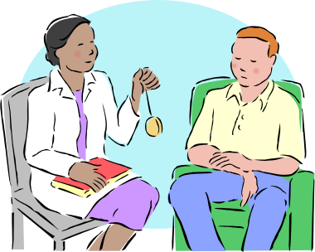
Seek Emotional Support
In times of stress it’s important to be able to share your feelings and seek emotional support
Recognize the potential support in your life (friends, family, classmates)
Utilize personal counseling services at the Student Health Center
Meet with your academic counselor
Join community groups, student clubs or social groups

Slide 17
Use Coping Skills to Manage Stress
Coping with stress is essential for making your life more productive and enjoyable
Coping means learning how to:
- Manage personal problems
- Solve personal problems
- Reduce stress and conflict

Slide 18
Review Stress Pattern Worksheet
Review your stress responses as a way to illustrate your thinking process. What are some patterns you see in your coping strategies? Circle or underline them.
Do you tense up?
Reach for something to eat?
Do you get impatient or angry?
Are you reduced to tears?
Do you give up?
Do you let negative thoughts take over?
- These are only temporary ways to reduce stress and will cause more damage in the long run.

Slide 19
Review Worksheet
We can apply some of the strategies we learned today about stress management on ourselves.
Review Worksheet: Recall a recent stressful event. What were the stress triggers? How did you react to the stress on an emotional, behavioral and physical level? What was your perspective on the situation?
Now lets come up with new strategies to address the stressful event. How can we reframe the problem? What are new coping strategies that can be used? What can you do to prevent or reduce the stress? Pair up with a student to share your responses.

Slide 20
Reflection Worksheet
Complete the Reflection Worksheet and discuss what you learned with your classmates as a group.

